Slide 1
Skill Focus: flashback, Foreshadowing, static & dynamic characters , irony
8.5.15, 8.5.17, 8.5.7, 8.5.10

Slide 2
Flashback
When an author interrupts the present action to show events that happened at an earlier time.
https://www.youtube.com/watch?v=3YG4h5GbTqU
What would the reader gain from this?
  Background information
  Motive
  Adds to the characterization of the character
  Reveals plot elements needed to get the “full picture”

Slide 3
Foreshadow
The use of clues or hints to suggest events that will occur later in the plot.
What would the reader gain from this?
  Used to build suspense or anxiety in a story
  Allows the reader to make connections between plot events

Slide 4
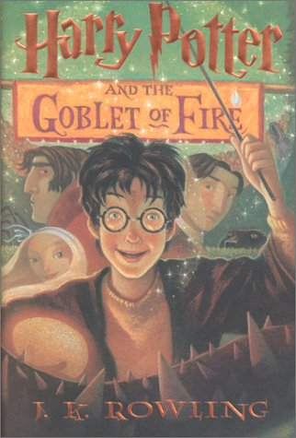
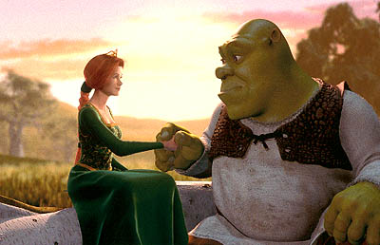

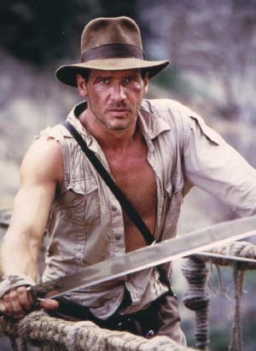


Characters
Protagonist – The main character in a work of literature who is involved in the central conflict.
  This person doesn’t necessarily have to be the hero. It can be the anti-hero.

Slide 5
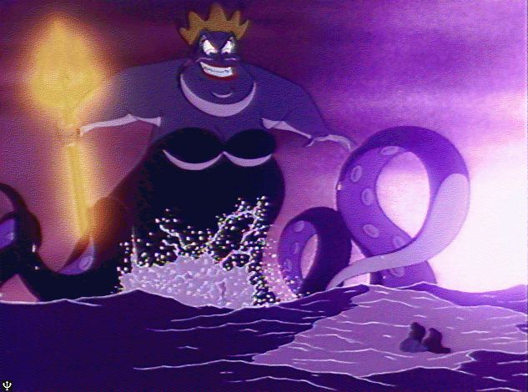
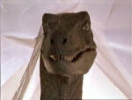

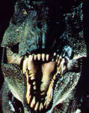
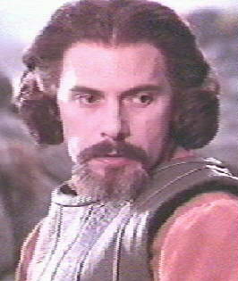
Characters
Antagonist – The character that is opposing or going against the protagonist.
can be inanimate (for example, a force)

Slide 6
Characters
Static vs. Dynamic
Static characters remain the same. They DO NOT CHANGE much in the course of the story.
Dynamic characters change as a result of events that occurred in the story. Meaning, internal changes not external changes!!
Let’s think about The Hunger Games book …

Slide 7

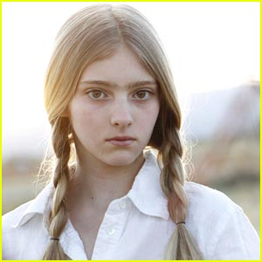
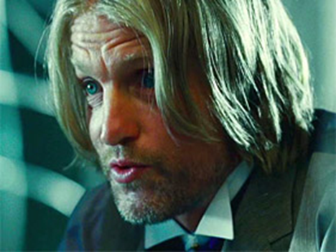
Static vs. Dynamic
Prim Everdeen
Haymitch abernathy
Beginning of the novel is a drunk who has given up on helping others
Later on he realizes his district has a chance and agrees to train the tributes

Slide 8
applying knowledge …
Think back to previous stories…
- “Raymond’s Run”
- “The Treasure of Lemon Brown”
- “The Outsiders” or “Freak the Mighty”
- “Life or Death” or “In the Margins”
  Which character(s) were dynamic and changed and grew during the story?
  Which were static characters who experienced little change throughout the story?

Slide 9
Characters continued…
Flat vs. Round
Flat characters are minor characters. We only know 1-2 things about them.
Round characters are FULLY DEVELOPED characters that we know almost everything there is to know about them.

Slide 10
Irony
Irony is a contrast between what is expected and what actually happens or exists.
  Situational irony – a contrast between what is expected to happen and what actually happens
  Verbal irony – occurs when someone states one thing and means another
  Dramatic irony – when readers know more about a situation or character than the characters do

Slide 11
Irony practice
Lois Lane, a reporter at the Daily Planet, is in love with the superhero Superman. She is obsessed with him and always asks her co-worker, Clark Kent, for information about him. She thinks that Clark and Superman are friends. However, Clark is actually Superman in disguise and is very much in love with Lois, but she won’t give Clark the time of day.
  A. Verbal irony
  B. Dramatic irony
  C. Situational irony
  D. No irony

Slide 12
Irony practice
A son reluctantly walked outside to meet his father in the yard at 6:00 on a Saturday morning. “Are you ready to do some yard work?” his father asked. “Yeah, I can’t wait,” the boy replied.
  A. Verbal irony
  B. Dramatic irony
  C. Situational irony
  D. No irony

Slide 13
Irony practice
Janice begins to receive threatening notes in the mail and on her car. Then, a car tries to run her over in a dark parking lot. She can’t see who the driver is. She goes to her best friend Doug for help. However, her attacker keeps trying to kill her. Finally, Doug has her come stay with him at his cabin so she will be safe. Then, he reveals that HE is the attacker!!
  A. Verbal irony
  B. Dramatic irony
  C. Situational irony
  D. No irony

Slide 14
Irony practice
Cinderella, a penniless house slave to her step-mother and two step-sisters, goes to a ball held for the prince. The prince believes that Cinderella is a royal lady since she is at the ball and is so beautiful. He falls in love with her, not knowing that she is a maid in her step-mother’s house.
  A. Verbal irony
  B. Dramatic irony
  C. Situational irony
  D. No irony

Slide 15
Irony practice
When this movie opens, we see a town and the setting appears to be early-Colonial America (i.e. the Puritans). The town is attacked regularly by creepy rat-like monsters in red cloaks. One of the members of the town falls very ill, and they need to send someone to another town for medical supplies. They choose to send a blind girl in the town, who leaves on her journey, having to run from the monsters. When she reaches the main road, a truck picks her up and we realize that the setting is not early-American but present day!
  A. Verbal irony
  B. Dramatic irony
  C. Situational irony
  D. No irony

Slide 16
Irony practice
Ashley is six feet tall. She will only date guys who are 6’3 and above. One night, she saw a guy who was less than 5 feet tall. She said, “Yeah, he definitely meets my height requirement.”
  A. Verbal irony
  B. Dramatic irony
  C. Situational irony
  D. No irony

